Slide 1

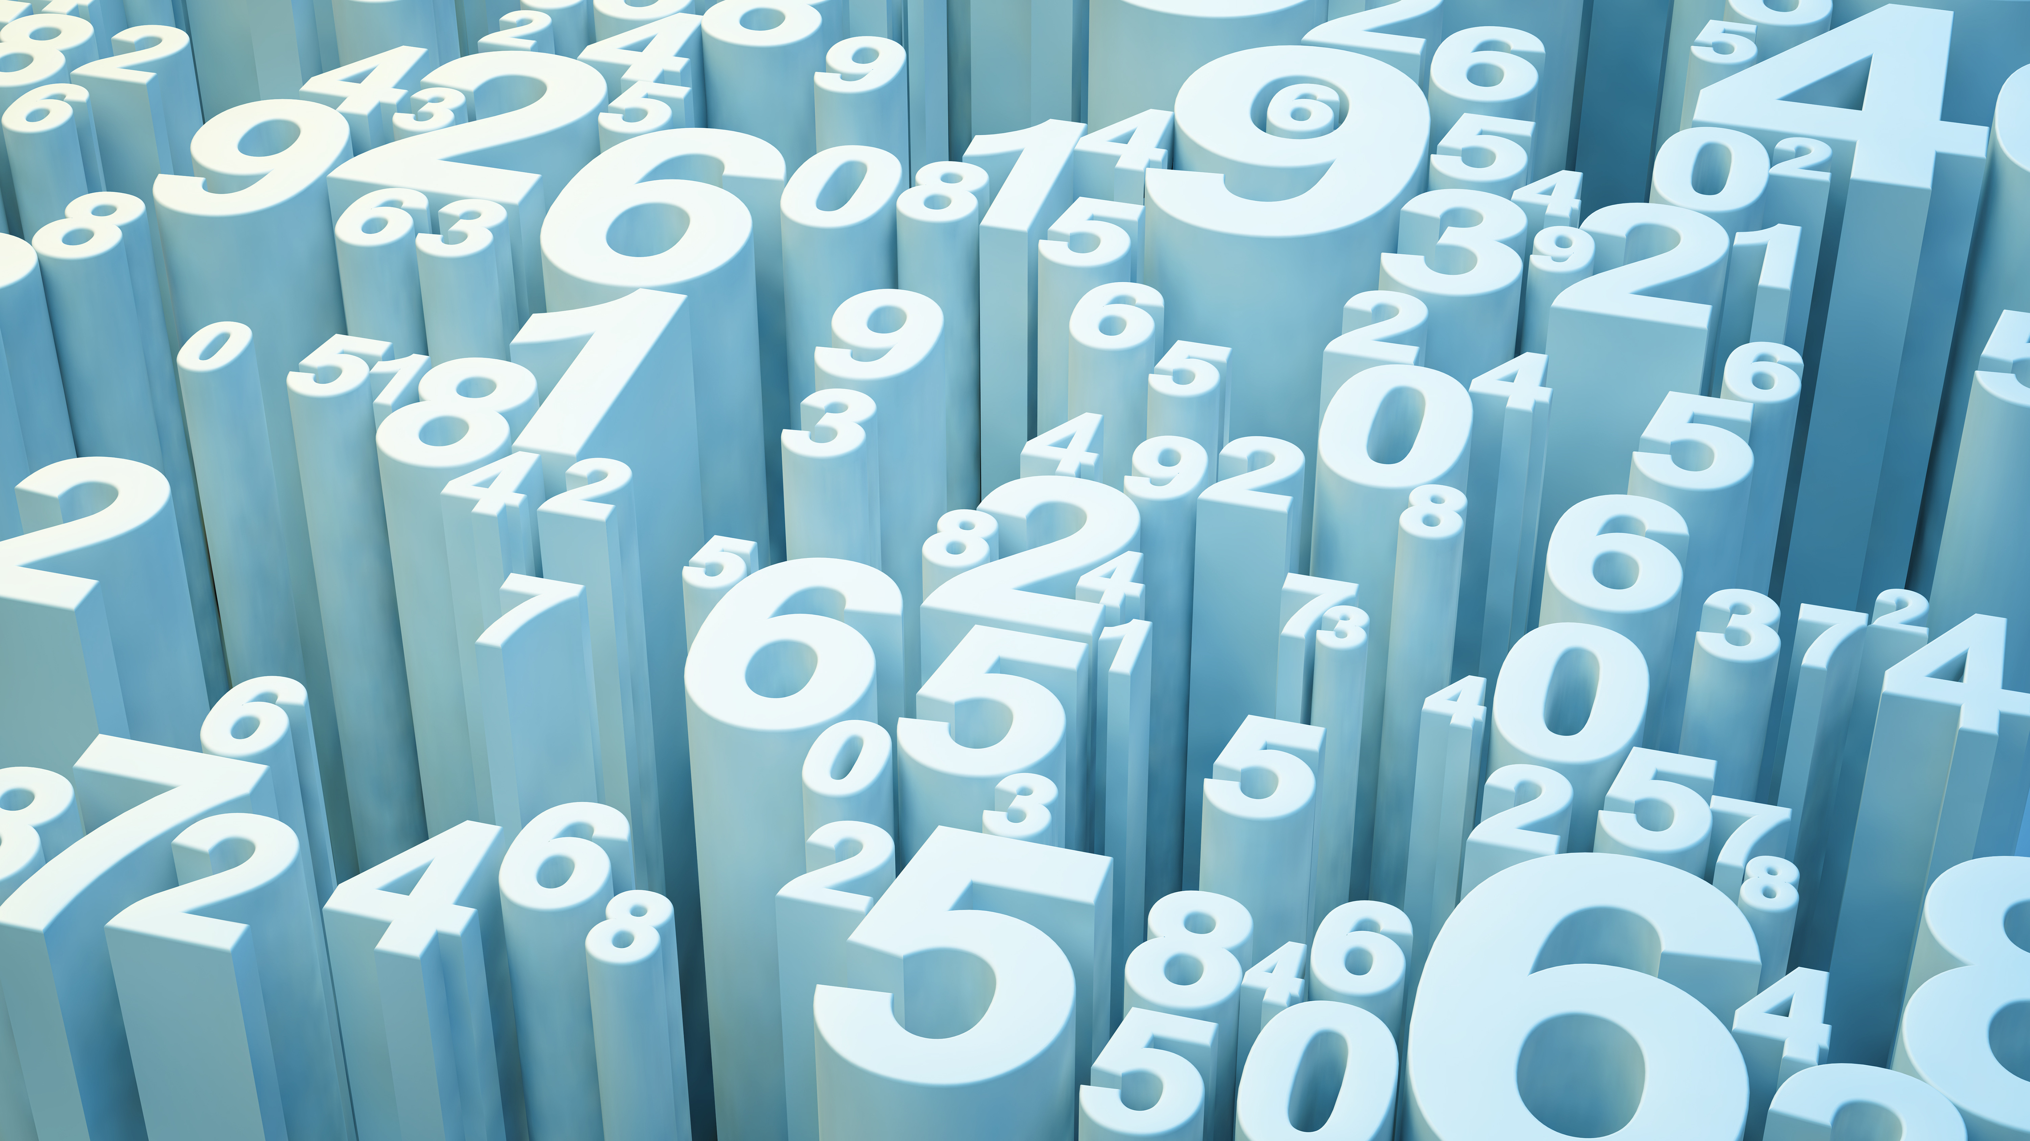
Data Science
Hayk Minasyan

Slide 2
Outline
Data scraping
Data cleaning
Data visualization

Slide 3
Data scraping
Normalize data into CSV format using Pandas
Data is ready for consolidation and wrangling
Get HTML response from
naukri.com
Extract data using Beautiful Soup and Selenium

Slide 4
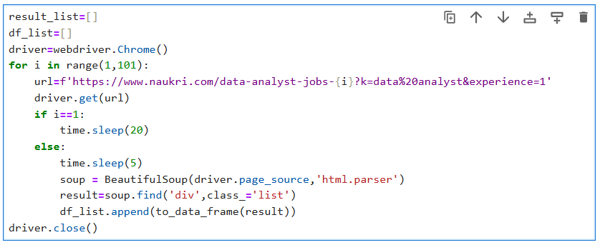
Collecting web page data using Selenium and Beautiful soup

Slide 5
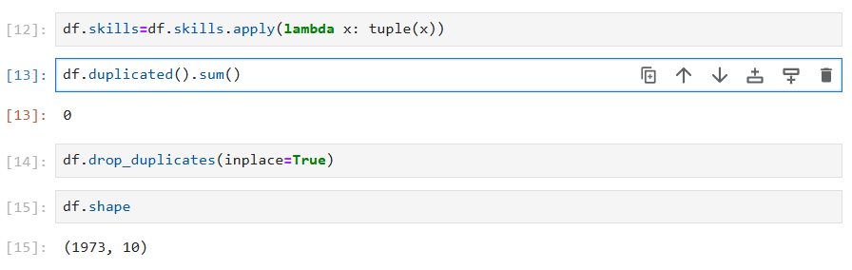
Data cleaning
Dealing with duplicates

Slide 6
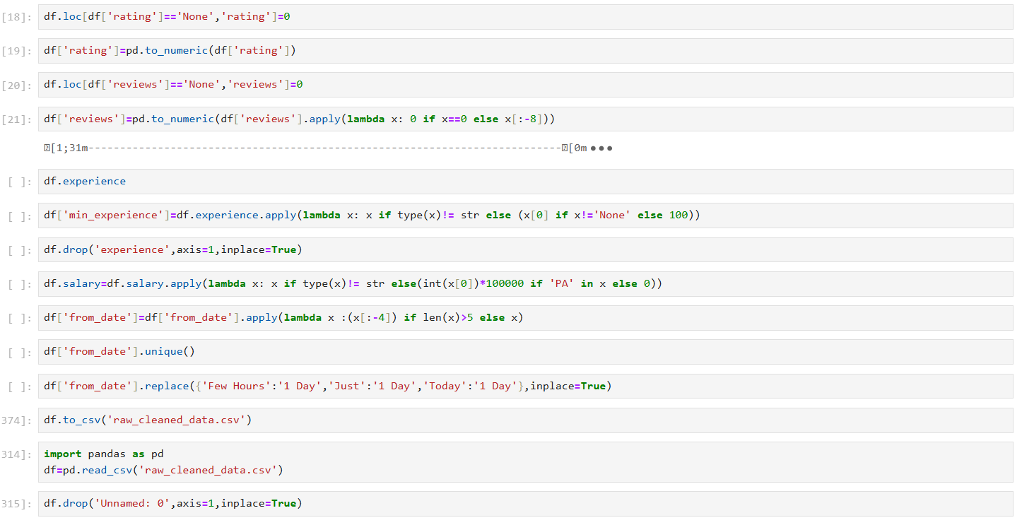
Changing the data types

Slide 7
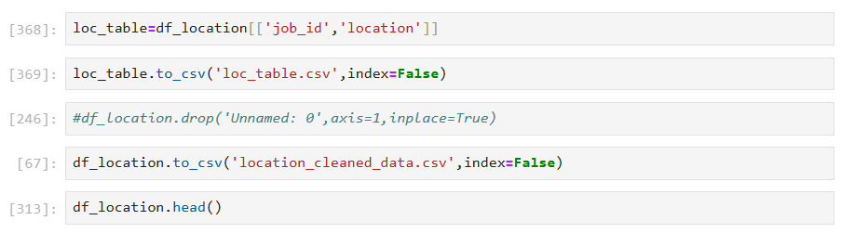
Creating a new csv file wit job id and locations

Slide 8
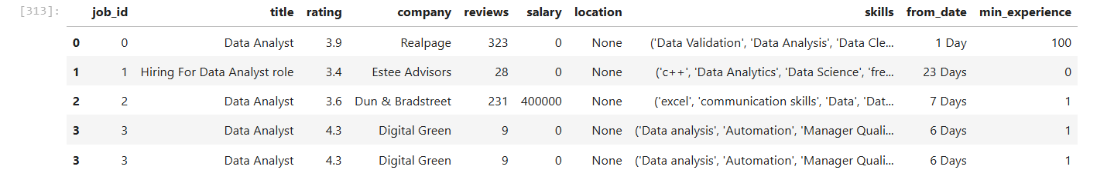
Split skills to individual raws

Slide 9
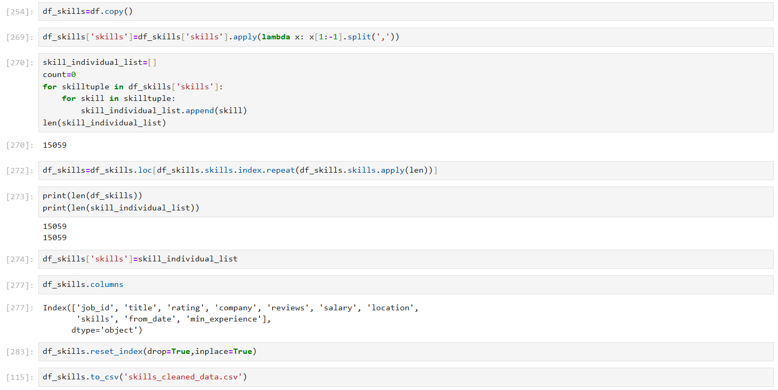

Slide 10
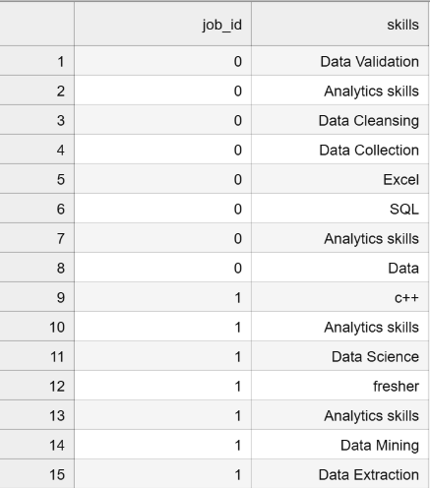

Slide 11
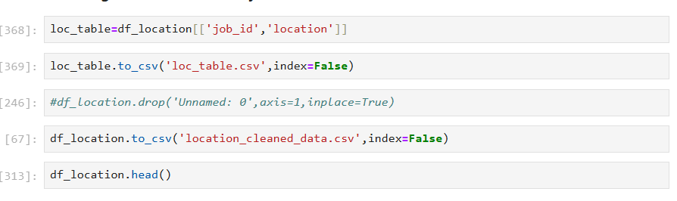
Creating a new csv file with job id and locations

Slide 12
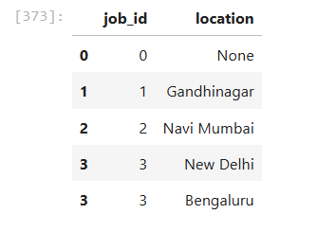

Slide 13
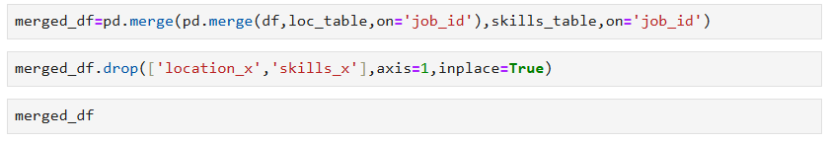
Joining the data frames

Slide 14
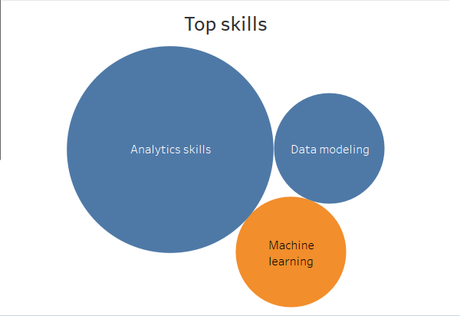
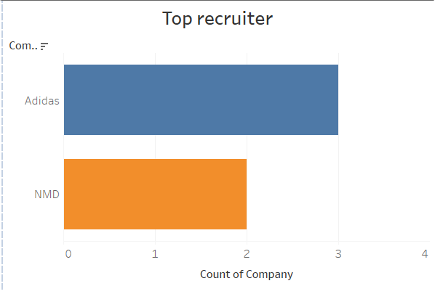
Data Visualization with Tabuleau
Juniur Data sciencist

Slide 15
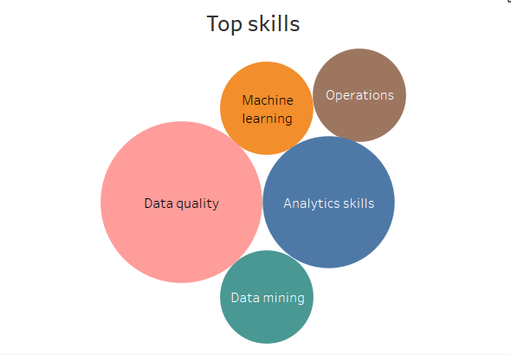
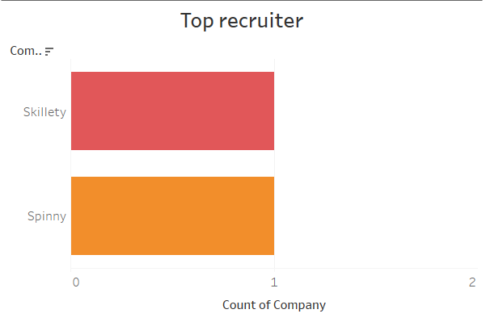
Data engineer

Slide 16
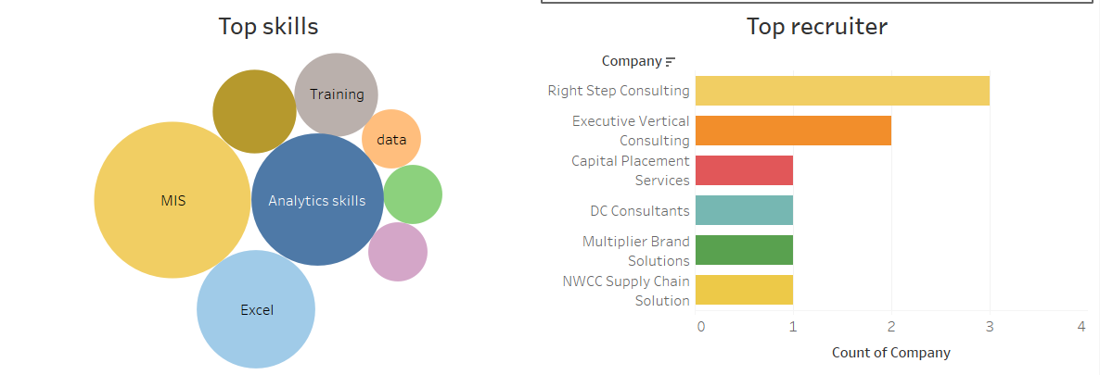
MIS Executive

Slide 17
Thank you

